Slide 1
MODULE ONE-:PROJECT
NAME – Diksha Aviral
COLLEGE – SRM Institute of Science and Technology
YEAR OF STUDY – Second Year

Slide 2


Slide 3
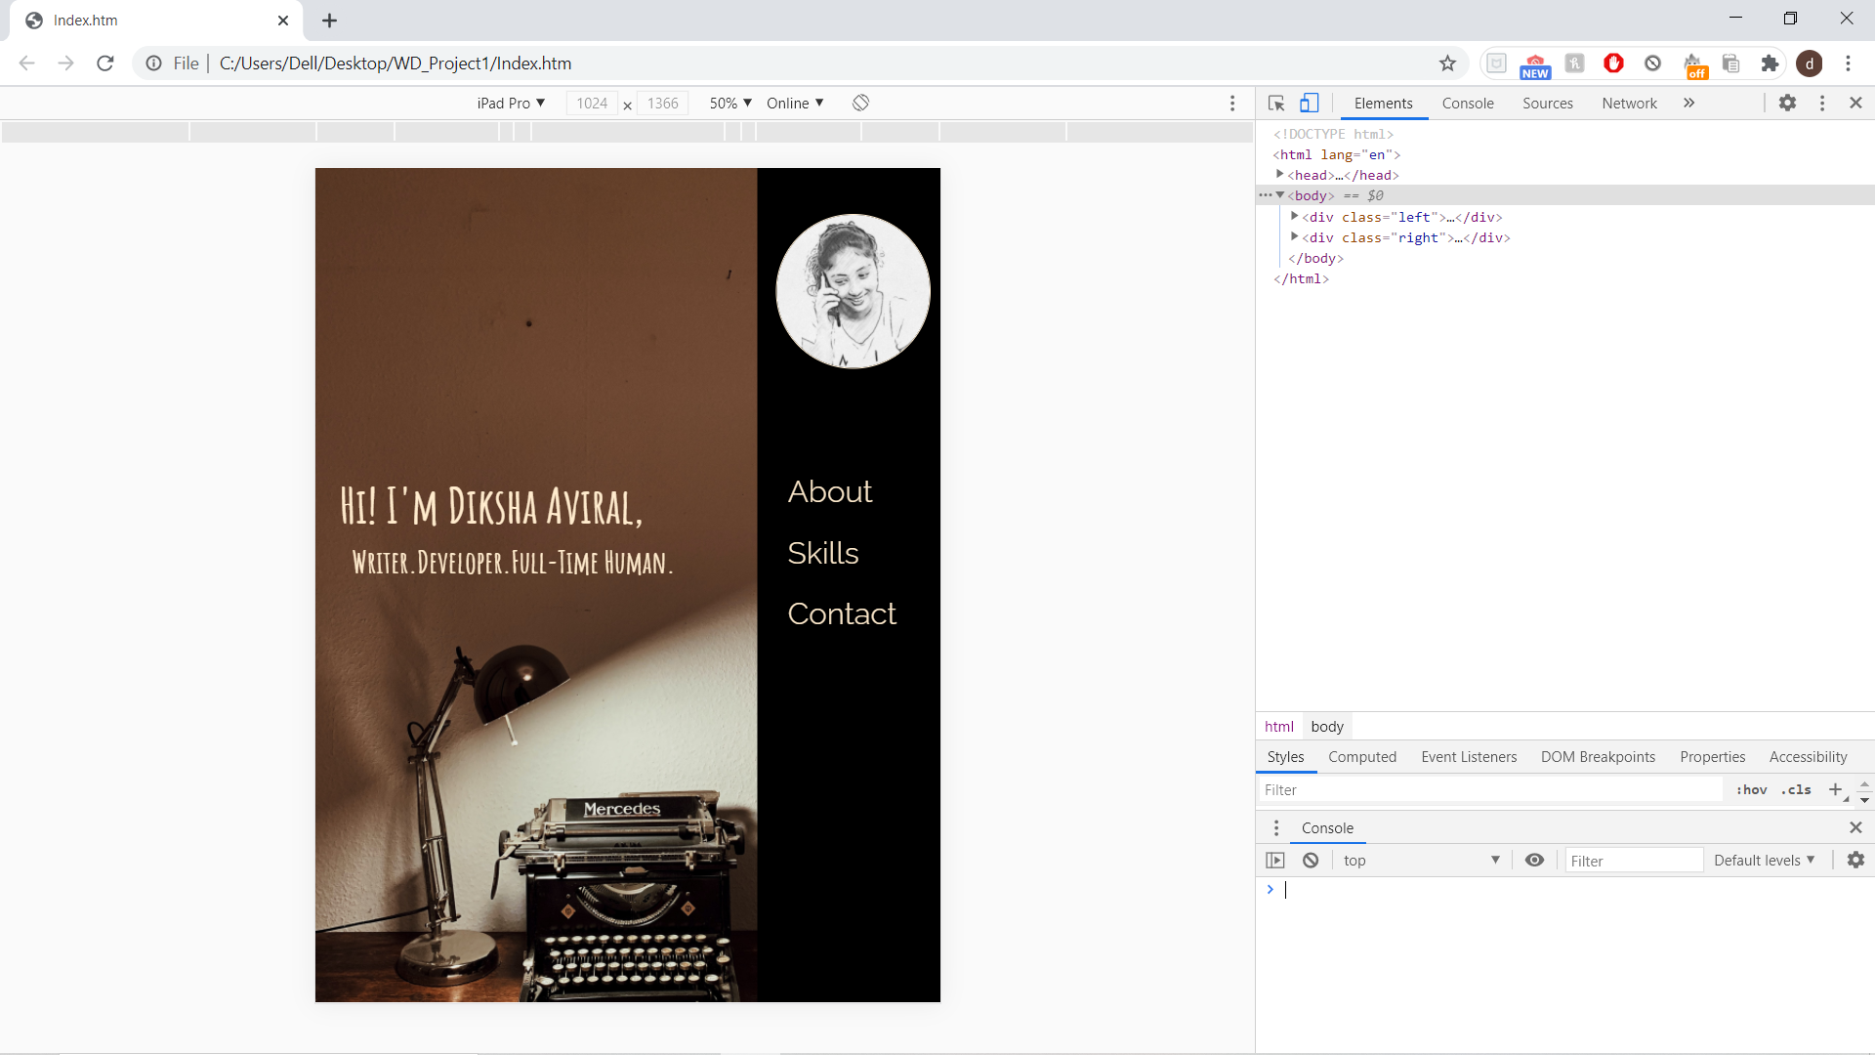

Slide 4


Slide 5
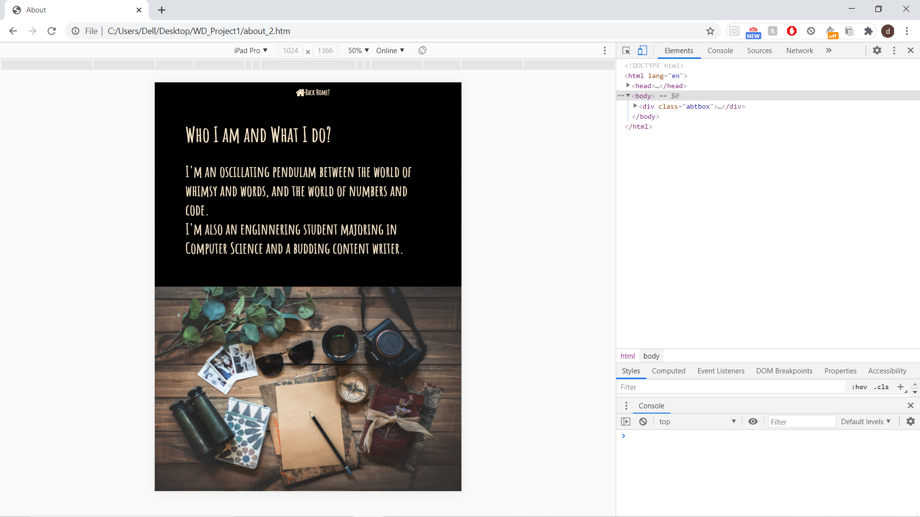

Slide 6
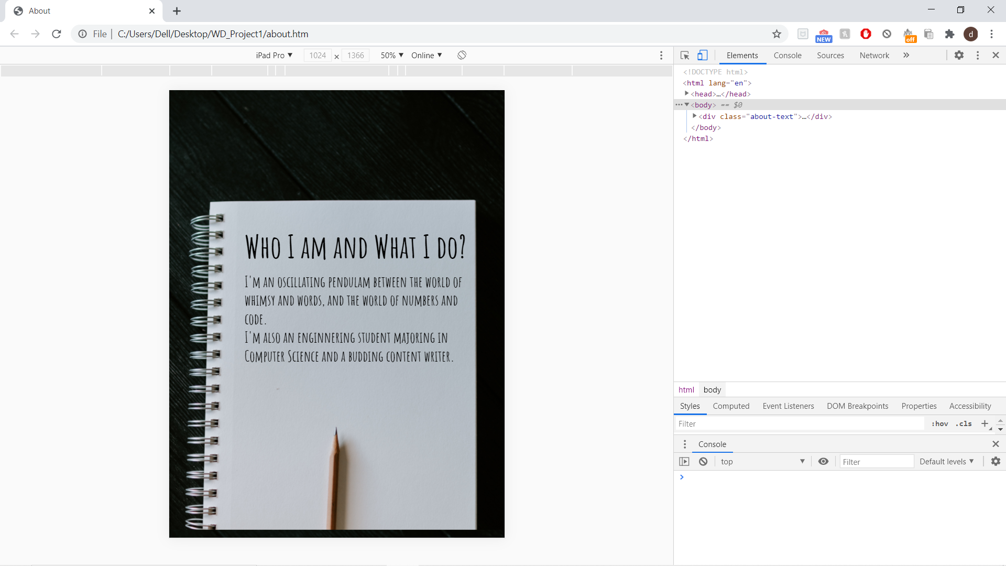

Slide 7


Slide 8
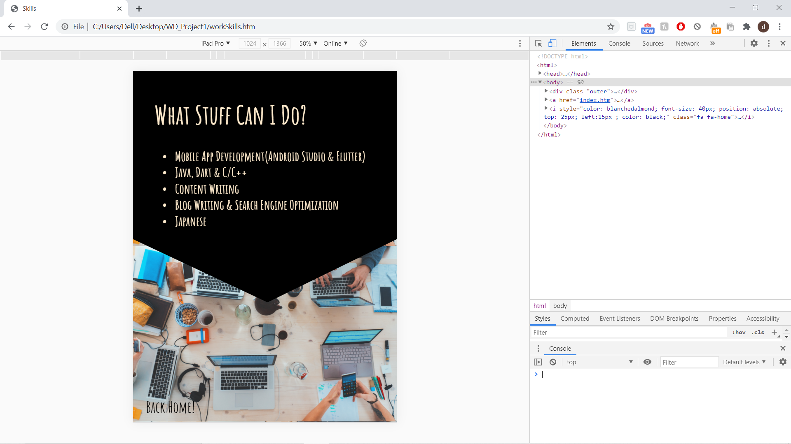

Slide 9


Slide 10
